Slide 1

Kanban
A method to manage flow

Slide 2

Origins
Literally “signboard”
Developed by Taichii Ohno at Toyota beginning in the late 1940s
Used for tracking production and process visibility within a factory
Part of the “Ohno System” or “Toyota Production System
Later became a part of what is known as “Lean Manufacturing”

Slide 3
Core Practices
Limit WIP
Pull
Visualize Work
Set Explicit Policies
Implement Feedback loops

Slide 4
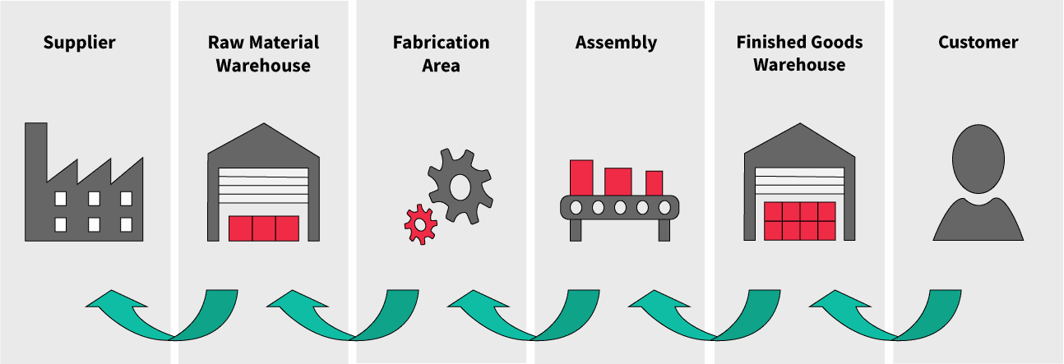
A (simple) Kanban System example

Slide 5
Relationship to Agile
2001: Agile marked a shift in software development for producing software
Creators were heavily influenced by systems thinking
2003-2010: Deeper relationship develops between Agile and Lean
Lean Software Development: An Agile Toolkit: Poppendieck, Mary, Poppendieck, Tom: 9780321150783: Amazon.com: Books
Today: Agile and Lean very intertwined, both needed to produce software.

Slide 6
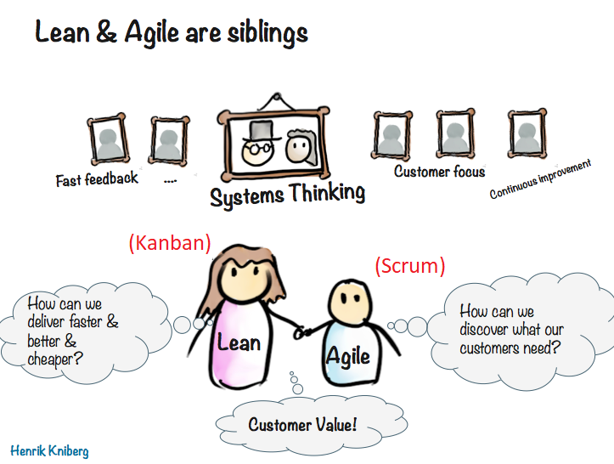

Slide 7
“Doing” Kanban
Active management of the flow of work through the system
Active meaning hands on, focused on movement, making adjustments/fixes as they are recognized
System meaning the complete system, a holistic view, not an individual part.
Only when we are actively managing the flow of work through the system can we truly say we are “doing” Kanban

Slide 8
What about Jira?
“We have a Kanban project in Jira, are we doing Kanban?”
Maybe…Maybe not
Atlassian muddied the waters when they developed these features for Jira. These two types of projects are basically the following…
1. A Kanban board with the timebox features present. (Scrum project)
2. A Kanban board without the timebox features present. (Kanban project)

Slide 9
Disclaimer
Software development work has unique concerns that make it distinct from manufacturing work.
Design is the work, “production” is copying files
Comparisons between the two focus on meta paradigms
Theory of Constraints/Queuing Theory
Systems thinking
Little’s Law

Slide 10
A couple videos
Henrik Kniberg : Multiple WIP vs One Piece Flow Example ~ 7 mins
The resource utilization trap ~ 6 mins

Slide 11


